Slide 1
Twitter: #maratonaopensource

Slide 2
VSCode and Containers
Vinícius Souza - @visouza_br
Sr. Technical Evangelist
Github.com/ViniciusSouza
Twitter: #maratonaopensource

Slide 3
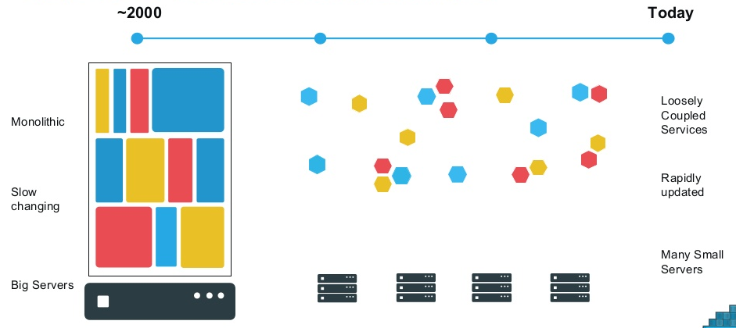
As Aplicações mudaram radicalmente

Slide 4
O novo desafio das aplicações distribuídas
Static Website
Analytics DB
User DB
Background Workers
Web Front End
Queue
API Endpoint
Development Test & QA Production Scale Out
Virtual machines
Disaster Recovery
Server Cluster
Developer Laptop
Server
Data Center
Public Cloud

Slide 5
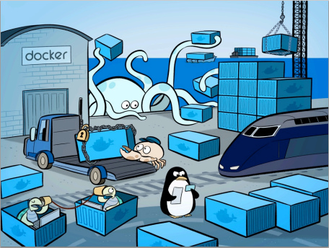
Docker

Slide 6

Containers Docker e VMs
Host OS - Hardware
Hyper Visor
Guest OS #1 (Virtual Machine)
Guest OS #2 (Virtual Machine)
Guest OS #3
Docker Daemon

Slide 7
App A
App A’
App B
Containers são isolados, compartilham o SO e, quando apropriado, binários e bibliotecas.
Bins/Libs
Bins/Libs
Bins/Libs
Guest OS
Guest OS
Guest OS
App A
App A’
App B
App B’
App B
App B’
App B
App B’
Bins/Libs
Bins/Libs
Hypervisor
Docker Engine
Host OS
Host OS
Server
Server

Slide 8
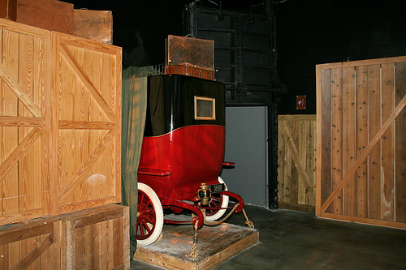
Revolução dos Containers

Slide 9
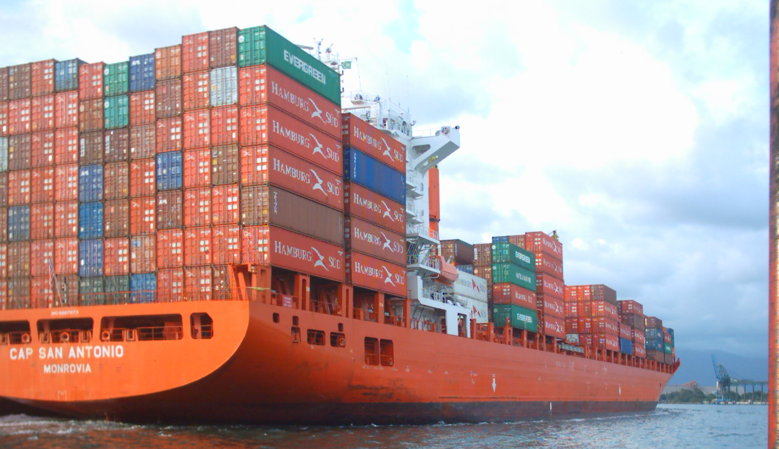
Revolução dos Containers

Slide 10
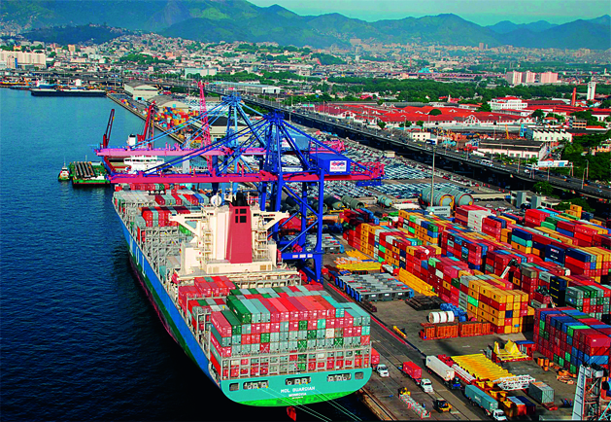
Revolução dos Containers

Slide 11
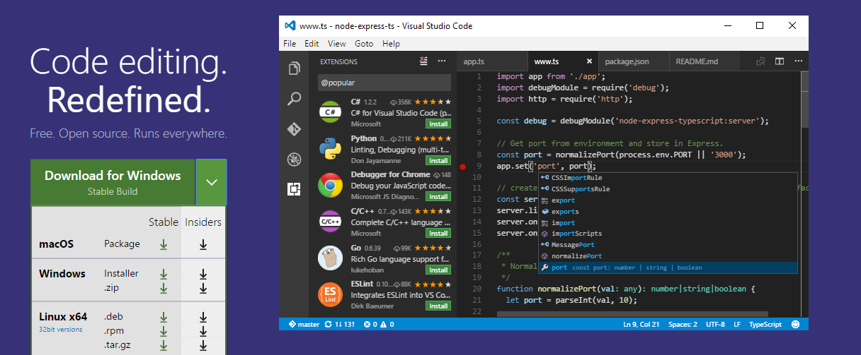
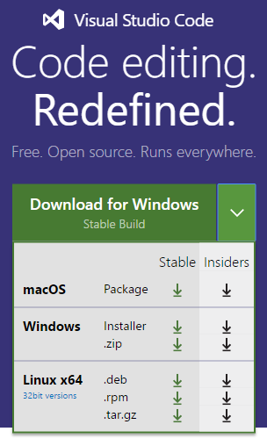
Visual Studio Code
https://code.visualstudio.com/

Slide 12
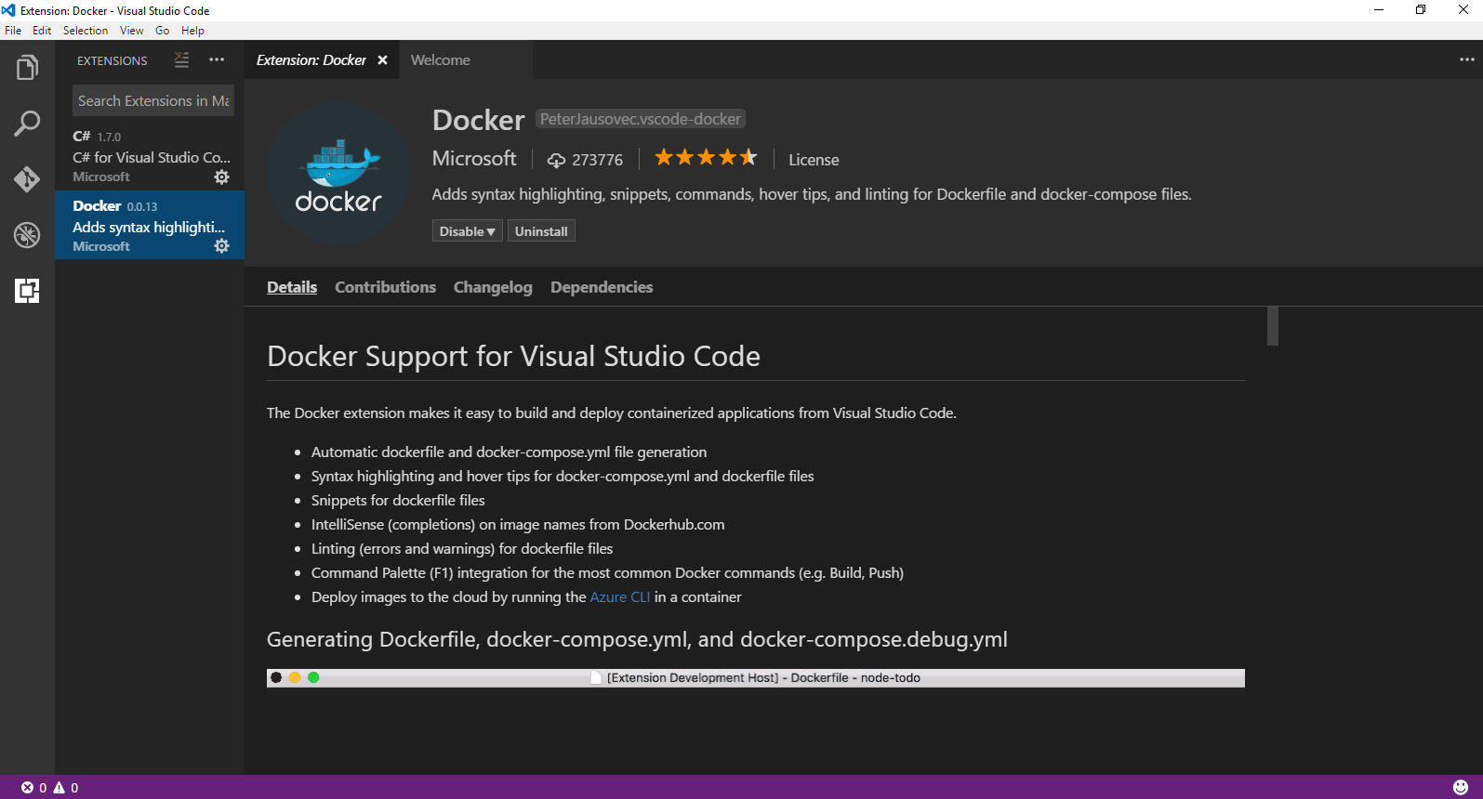
Visual Studio Code Extensions

Slide 13

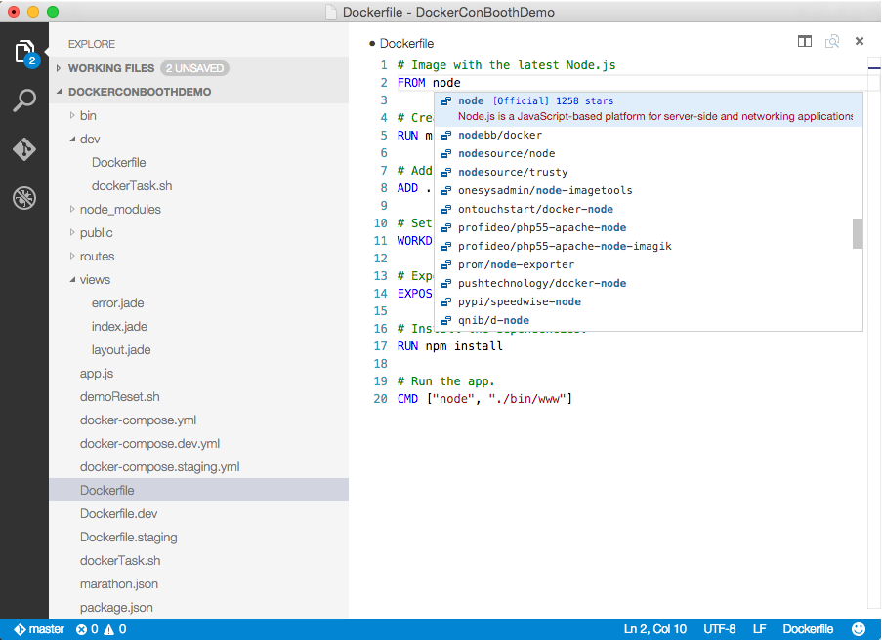
Visual Studio Code
OS X, Linux, Windows
Lightweight, keyboard focused
IntelliSense, GoTo Def, refactoring
Git SCC integration
Extensible platform
Docker Asset Editing - extension
aka.ms/VSCode
aka.ms/DockerToolsForVSCode

Slide 14
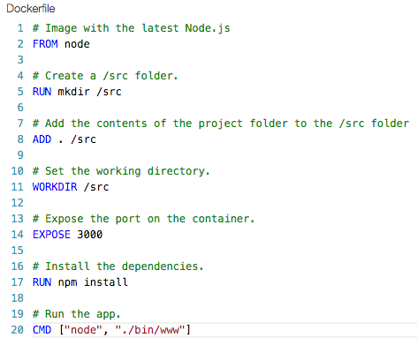
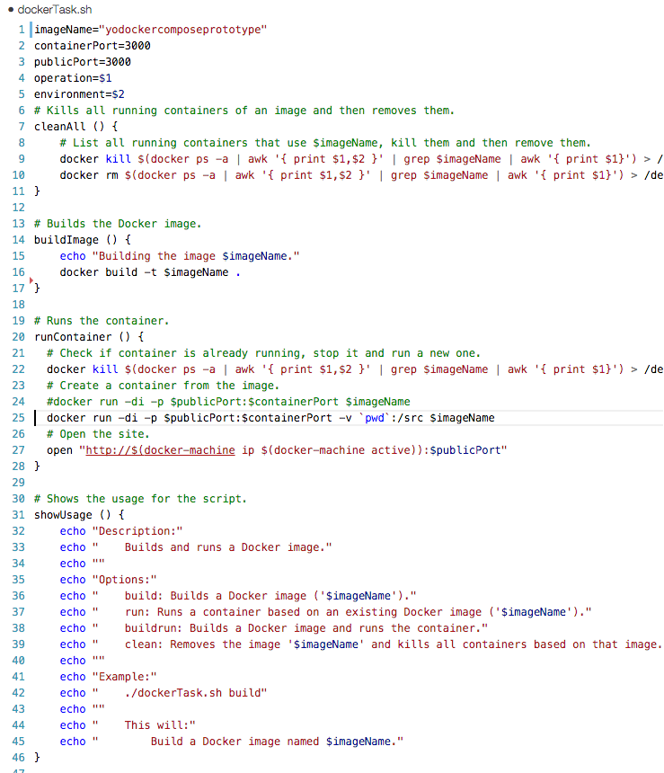
Bootstrapping the developer
Developers need a means to get started
Scaffolds initial assets
(Dockerfile.*, docker-compose.*.yml, bash and powershell scripts)
yo docker
aka.ms/YoDocker

Slide 15
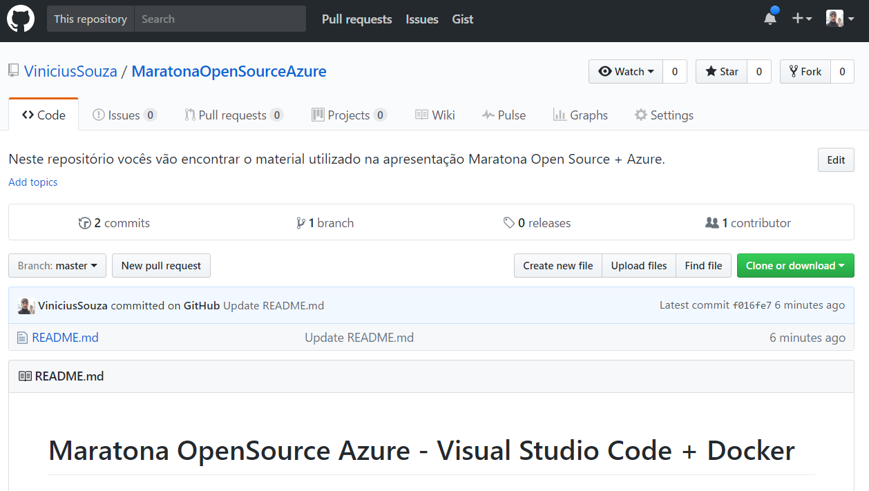
GitHub Repositório
https://github.com/ViniciusSouza/MaratonaOpenSourceAzure

Slide 16
Demo1 – Instalando o Tomcat no Windows
C:\Users\visouza>docker pull tomcat
Using default tag: latest
latest: Pulling from library/tomcat
6d827a3ef358: Already exists
2726297beaf1: Already exists
d6e483851652: Pull complete
0ab260573986: Pull complete
b7c48cee0b2b: Pull complete
1368ab15aa1c: Pull complete
e4b9c85c3e06: Pull complete
ee3dc5d1e4c7: Pull complete
e101174ccdbd: Pull complete
c2314a094b7b: Pull complete
a9d5ec3c3ff3: Pull complete
Digest: sha256:a45d6a36ed6e66d7cd485cfec97a2b54254924542038802323fa42a74e9423b0
Status: Downloaded newer image for tomcat:latest
C:\Users\visouza>

Slide 17
Demo1 – Instalando o Tomcat no Windows
C:\Users\visouza>docker images
REPOSITORY TAG IMAGE ID CREATED SIZE
demo2 latest 31ac9a8da692 8 hours ago 183 MB
demo1 latest fdab952cd763 9 hours ago 183 MB
sample1 latest 855ab213894a 12 hours ago 1.19 GB
nginx latest 5e69fe4b3c31 15 hours ago 183 MB
tomcat latest 2da861e12a55 5 days ago 357 MB
microsoft/aspnetcore-build latest 9059c0478788 6 days ago 1.19 GB
microsoft/aspnetcore latest 2628aaa7b8cf 6 days ago 288 MB
hello-world latest 48b5124b2768 2 months ago 1.84 kB
user/arda.reports dev d376996b962c 4 months ago 268 MB
user/arda.main dev 7471986194ce 4 months ago 268 MB
user/arda.kanban dev 40a7ef17d7b9 4 months ago 268 MB
user/arda.permissions dev 4f8bcceb735f 4 months ago 268 MB
microsoft/aspnetcore 1.1.0 6033ab9bf81e 4 months ago 268 MB
microsoft/aspnetcore 1.1.0-preview1 82e691abe872 4 months ago 268 MB
microsoft/aspnetcore 1.0.1 a9fd4e85954f 4 months ago 267 MB
d4w/nsenter latest 9e4f13a0901e 6 months ago 83.8 kB
C:\Users\visouza>

Slide 18
Demo1 – Instalando o Tomcat no Windows
C:\Users\visouza>docker run -d -p 8080:8080 tomcat
5893912648a95d6c3f39fe55a781b311820a9c7b6414724e9a40e99fd2cac95e
C:\Users\visouza

Slide 19
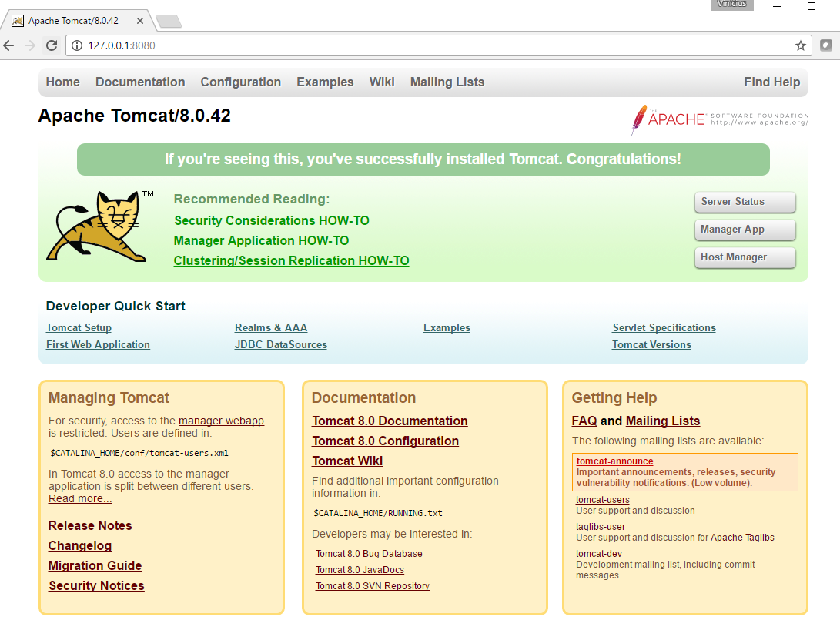
Demo1 – Instalando o Tomcat no Windows

Slide 20
Legal, Mas de onde veio o Tomcat?

Slide 21
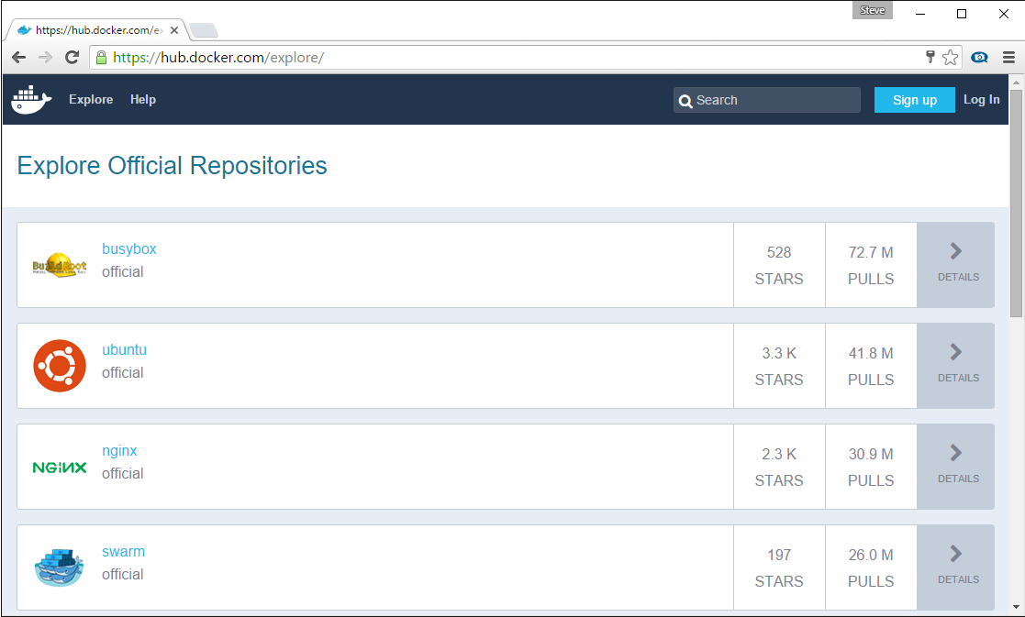
Docker Registry
Armazena as imagens docker
Searchable
Public Registry – Hub.Docker.com
Private Registries – Instanced for you
Pode ser hospedado no Docker, Azure and etc.

Slide 22









Docker API
Client
DOCKER_HOST
Registry
Docker pull
Docker daemon
Docker run
Containers
Images Cache
Dot Net
Dot Net
Dot Net
Dot Net

Slide 23
Componentes Docker
Docker Engine: Docker client + Docker Daemon;
Docker Kitematic: GUI App utilizada para gerenciar e criar imagens e containers;
Docker machine: Command line Tool que ajuda a criação de hosts Docker;
Docker Compose: A YAML-based tool utilizada para criar ou compor imagens Docker;
Docker Linux Image: Na nova versão utilizando o Hyper-V para Windows e nativo no Linux.

Slide 24
Demo2 – Construnindo uma imagem
C:\Users\visouza>docker build . -f Dockerfile -t demo2
Sending build context to Docker daemon 4.608 kB
Step 1/4 : FROM nginx
---> 5e69fe4b3c31
Step 2/4 : WORKDIR app
---> Using cache
---> 0df60df30134
Step 3/4 : COPY wwwroot /usr/share/nginx/html
---> Using cache
---> 3e4a868b8831
Step 4/4 : EXPOSE 80
---> Using cache
---> fdab952cd763
Successfully built fdab952cd763
C:\Users\visouza>

Slide 25



Docker build
Registry
DOCKER_HOST
Private Registry
dockerfile
Docker daemon
FROM nginx
WORKDIR app
COPY wwwroot /usr/share/nginx/html
EXPOSE 80
Containers
Images
Code/Binaries
Todos os assets disponíveis na pasta
Client
Docker build
Docker run
Docker push

Slide 26
Demo2 – Construnindo uma imagem
C:\Users\visouza>docker run -i -t -p 9000:80 demo2
http://localhost:9000

Slide 27
Demo3 – Utilizando Volumes
C:\Users\visouza>docker build . -f Dockerfile -t demo3
Step 1/3 : FROM nginx
---> 5e69fe4b3c31
Step 2/3 : WORKDIR /
---> Using cache
---> b9ec0ad9da5d
Step 3/3 : EXPOSE 80
---> Using cache
---> 31ac9a8da692
Successfully built 31ac9a8da692
C:\Users\visouza>

Slide 28
Demo3 – Utilizando Volumes
C:\Users\visouza>docker run -i -t -p 9000:80 -v C:\Users\visouza\Repos\MaratonaOpenSourceAzure\Demo3\wwwroot:/usr/share/nginx/html demo3
Docker run -v hostpath:/containerpath
http://localhost:9000

Slide 29
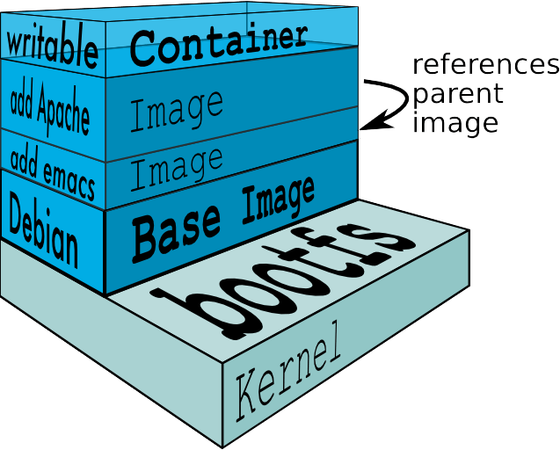
Docker Layers
ImageLayers.io

Slide 30
Intânciando multiplos serviços
Como instanciamos vários serviços diferentes ao mesmo tempo?
Está construindo Micro Services?
Como gerenciar as configurações entre os serviços?

Slide 31

Docker-Compose.exe
API sobre o docker run
Utilizado para instanciar multiplos containers
Pode fazer referênciar dockerfiles e/ou imagens
Utiliza o docker-compose.yml

Slide 32
Demo4: Docker Compose
version: '2'
services:
web:
build:
context: ./web
environment:
- ImageApiUri=http://imageapi/api/image
ports:
- "5000:80"
depends_on:
- imageapi
imageapi:
build:
context: ./webapi
ports:
- "8080:80"

Slide 33
Demo4: Docker Compose
C:\Users\visouza\Repos\MaratonaOpenSourceAzure\Demo4>docker-compose build
Building imageapi
Step 1/6 : FROM microsoft/aspnetcore-build
---> 9059c0478788
Step 2/6 : WORKDIR /app
---> Using cache
---> 886ea37e5ff2
Step 3/6 : COPY . .
---> Using cache
---> 9ae4dcf78dc4
Step 4/6 : RUN dotnet restore
---> Using cache
---> 7ed24da50bab
Step 5/6 : EXPOSE 80
---> Using cache
---> 1d069086e3f8
Step 6/6 : ENTRYPOINT dotnet run
---> Using cache
---> 7bb2d86ad28b
Successfully built 7bb2d86ad28b
Building web
Step 1/6 : FROM microsoft/aspnetcore-build
---> 9059c0478788
Step 2/6 : WORKDIR /app
---> Using cache
---> 886ea37e5ff2
Step 3/6 : COPY . .
---> 30316baf46d4
Removing intermediate container 01556fdd34aa
Step 4/6 : RUN dotnet restore
C:\Users\visouza>

Slide 34


Docker compose
Docker-compose.yml
Registry
version: '2'
services:
web:
build:
context: ./web
environment:
ImageApiUri=http://imageapi/api/image
ports:
- "5000:80"
depends_on:
- imageapi
imageapi:
build:
context: ./webapi
ports:
- "8080:80"
DOCKER_HOST
Docker daemon
Containers
Images
Dot Net
frontend
web
api
webapi
Client
Docker-compose

Slide 35

Container Workflow
Test
SCC
Registry
Docker-compose
Test.env
CI
Docker-compose.yml
Base Image
Staging
Dockerfile
Build
Docker-compose
Push
Compiled Code
Integration
Client
Stag.env
Int.env
Write/Edit
Docker build
Production
Debug
Docker-compose up
Docker-compose
Docker push
Tests
Run
Prod.env
Local Development Environment

Slide 36
Container Workflow
Test
Scheduling
Orchestration
Registry
SCC
Environment
CD
Staging
Integration
Write/Edit
Production
Debug
CI/Build Environment
Tests
Run
Local Development Environment

Slide 37











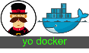
public registry
VM Scale Sets
Azure Container Service
Azure Hosted Docker Private Registry
ASP.NET
Test
Visual Studio Team Services
Azure Hosted Private Registry*
Source Code Control
Build
Continuous Integration
3rd Party Integration:
Azure Container Service
Staging
VSTS Build Agents w/ Docker
Orchestration & Scheduling - Marathon / Docker Swarm
Visual Studio
Integration
ASP.NET
In Container Development
Edit & Refresh
Breakpoint Debugging
Production
Debug
Write/Edit
Run
Visual Studio Code
Docker Language Services
Docker Scaffolding w/yo docker

Slide 38
Docker Tools for
Visual Studio Team Services
Docker Build Steps
Linux Build Agents
Release Management
aka.ms/DockerToolsForVSTS

Slide 39
Q&A
Se você possui dúvidas utilize a hashtag
#maratonaopensource

Slide 40
Ferramentas
Azure.com/Tools
aka.ms/yodocker
aka.ms/DockerToolsForVS
aka.ms/DockerToolsForVSCode
aka.ms/DockerToolsForVSTS
Serviços
aka.ms/AzureContainerService
aka.ms/WindowsContainers
PPT/Demos
github.com/ViniciusSouza/MaratonaOpenSourceAzure
Vinícius Souza
@visouza_br
Microsoft DXBrazil

